Slide 1

Vehicle Data Privacy Services
Designed exclusively for Automotive Dealership
Notes:
Talk track:
Personal data privacy in vehicles.
This is a NEW way to drive revenue.
Customers WANT THIS.
Let me show you.
[Next Slide]
—-----------------
Slide 1: “The current state of the world is [Mega-trend 1, 2, 3, etc. ...]”
Slide 2: “[Mega-trend] makes life challenging for business leaders like you because … [Implication 1, 2, 3]”
Slide 3: “... and this is only going to get harder in the future, because …”
Slide 4: “Today, the way most companies try to solve [Challenge/mega-trend] is… [‘Hire more people,’ ‘Spend more money, etc. …’].”
Slide 5: “... and here are the results most companies get [Mediocre results].”
Slide 6: “... but, there’s a small group of [Companies/business leaders] doing things differently ...”
Slide 7: “... and these are the results they’re getting [... should be far better than what the middle of the road company is getting in slide number five] ...”
Slide 8: “Here’s how it works … [this is where discuss your company’s solution/service/product].”
Slide 1: Introduction
Title: "Driving Revenue in a Challenging Market"
Image: A dealership lot with fewer customers than usual
Bullet points: "Economic uncertainty", "High interest rates", "Fewer buyers"
Slide 2: The Challenge
Title: "Volume vs. Value"
Split screen image: Left side showing a crowded dealership that is getting less crowded (representing volume), right side showing a single car & buyer with a spotlight (representing value)
Text: "In today's uncertain market, volume selling is out. We need to focus on extracting more value from each deal."
Slide 3: The Opportunity
Title: "A New Differentiator: Personal Data Privacy"
Image: Car dashboard with infotainment system
Chart: Showing the rise of data privacy as a buying factor (2022 vs 2023)
Key stat: "39% of buyers consider data privacy HIGHLY IMPORTANT"
Slide 4: The Solution
Title: "Privacy4Cars: Your Automotive Privacy Partner"
Logo: AutoCleared™ , VPR & Privacy Star Dealership logo
Connected car image: Phone numbers, call logs, location history, garage door codes
Tagline: "Differentiate with privacy, Upsell with confidence"
Slide 5: Our Products
Title: "AutoCleared™ , VPR, Badging
Three product boxes:
Product A (AutoCleared + badging)
Product B (VPR + badging)
Product C (stealth product --- coming soon)
Brief description of each product
Slide 6: Implementation Strategies
TBD --- likely images of our app & how to monetzie
Slide 7: Pricing and Call to Action
Title: "Unbeatable Early Adopter Pricing"
Large text: "$500/month"
Image: Coffee cup (to reinforce the "less than your coffee budget" point)
Call to Action button: "Differentiate Now with Privacy4Cars"
Most of the dealers I talk to — let me just say it isn’t the glory days of the pandemic-selling-era where vehicles were just driving themselves off the lot. Dealers are fighting for every dollar these days.
When revenue is down you got two options
Volume —-or —- value driven sales.
You either sell more cars.
Or add then extract more value out of the cars you ARE selling.
And in today’s market, volume selling is out. We can’t create more buyers. There’s too much out of our control. From uncertainty in the economy. High interest rates up from
Historical lows. There’s nothing in the macro economics like 0% interest rates of yesterday that are bringing new buyers off the sidelines.
So we only have the buyers who are actually looking to buy right now.
2 questions:
How do we make sure those buyers come to your dealership?
How do you add more value to the buyers and bring in more revenue?
You probably are thinking, Merry, we have maxed out. We’re upselling everything from x y z. And most of the dealers I’ve talked to say they’ve tried everything to add more value to the cars they are selling.
But I’m here to tell you there is something brand new on the scene. Something you’ve never heard before, that just popped up last year for the first time in 2023.
Personal data privacy in vehicles.
Every year, SBD Automotive does a survey about the top most important buying factors.
In 2022, data privacy wasn’t on the list.
But by 2023, 39% of buyers said data privacy as a HIGHLY IMPORTANT factor in them buying a car….more than the car’s styling, infotainment, and connected features.
That’s right. Privacy.
And it makes sense! Who wants the next guy reading their text messages. Or knowing their routes and locations? Or getting access to their contact lists?
If you think about it, it makes sense. You’d never open up your cell phone and just hand it to a stranger. Your car is the same — it’s like a smartphone on wheels.
And this new differentiator — data privacy — is what my dealership customers are cashing in on. Privacy is a differentiator.
If there are only so many people in the market buying cars, and we know that 95% of car sales start online, you best believe my dealerships are differentiating from the competition by putting data privacy-certified labels on each one of their cars for sale both online and on the showroom.
And then once you get customer in the door – my dealership customers are adding value to each deal by selling personal data deletions as an add-on service. Again, since we can’t do volume sales in this market, all we’ve got is value-add selling to increase revenues.
And that’s what our forward thinking dealer clients are doing.
Differentiating on privacy. Upselling privacy.
Now, I could go into how this all works, but want to stop and gut check — do you want to know more?
Ok – what do you want to know more about? I can talk about our products, how my customers are leveraging this, or pricing? Which do you want to cover first?
Ok – Products
We sell 2 main products and a third on the way.
Existing talk track.
Each one of our dealers does this differently – some offer it for free and market the shit out of this. Some charge a nominal fee at reconditioning,
Existing talk track.
Or pricing –
You’re going to laugh because this is ridiculously cheap. My CEO has a number in his mind — a customer count — and he’s giving our early-adopters a great price. I’ve got 29 more dealerships to go before I hit his number. Anyway, we charge $500/mo. That’s probably less than your coffee budget.
Is there any reason why you wouldn’t use privacy to differentiate your dealership & any reason why you wouldn’t offer this service to your customers?

Slide 2
New Jersey Mandate now in effect !!! In order to protect customer privacy the New Jersey Mandate states that dealers MUST OFFER Vehicle consumer data deletion services. Mandate further states Dealers have the option to change a reasonable fee
BEING NON-COMPLIANT CAN COST DEALERS $5000+ IN VIOLATION FEES AND POSES SIGNIFICANT RISK AND EXPOSURE
IVSG AND PRIVACY4CARS HAVE THE RIGHT ROBUST SOLUTION FOR DEALERS
Notes:
Talk track:
Personal data privacy in vehicles.
This is a NEW way to drive revenue.
Customers WANT THIS.
Let me show you.
[Next Slide]
—-----------------
Slide 1: “The current state of the world is [Mega-trend 1, 2, 3, etc. ...]”
Slide 2: “[Mega-trend] makes life challenging for business leaders like you because … [Implication 1, 2, 3]”
Slide 3: “... and this is only going to get harder in the future, because …”
Slide 4: “Today, the way most companies try to solve [Challenge/mega-trend] is… [‘Hire more people,’ ‘Spend more money, etc. …’].”
Slide 5: “... and here are the results most companies get [Mediocre results].”
Slide 6: “... but, there’s a small group of [Companies/business leaders] doing things differently ...”
Slide 7: “... and these are the results they’re getting [... should be far better than what the middle of the road company is getting in slide number five] ...”
Slide 8: “Here’s how it works … [this is where discuss your company’s solution/service/product].”
Slide 1: Introduction
Title: "Driving Revenue in a Challenging Market"
Image: A dealership lot with fewer customers than usual
Bullet points: "Economic uncertainty", "High interest rates", "Fewer buyers"
Slide 2: The Challenge
Title: "Volume vs. Value"
Split screen image: Left side showing a crowded dealership that is getting less crowded (representing volume), right side showing a single car & buyer with a spotlight (representing value)
Text: "In today's uncertain market, volume selling is out. We need to focus on extracting more value from each deal."
Slide 3: The Opportunity
Title: "A New Differentiator: Personal Data Privacy"
Image: Car dashboard with infotainment system
Chart: Showing the rise of data privacy as a buying factor (2022 vs 2023)
Key stat: "39% of buyers consider data privacy HIGHLY IMPORTANT"
Slide 4: The Solution
Title: "Privacy4Cars: Your Automotive Privacy Partner"
Logo: AutoCleared™ , VPR & Privacy Star Dealership logo
Connected car image: Phone numbers, call logs, location history, garage door codes
Tagline: "Differentiate with privacy, Upsell with confidence"
Slide 5: Our Products
Title: "AutoCleared™ , VPR, Badging
Three product boxes:
Product A (AutoCleared + badging)
Product B (VPR + badging)
Product C (stealth product --- coming soon)
Brief description of each product
Slide 6: Implementation Strategies
TBD --- likely images of our app & how to monetzie
Slide 7: Pricing and Call to Action
Title: "Unbeatable Early Adopter Pricing"
Large text: "$500/month"
Image: Coffee cup (to reinforce the "less than your coffee budget" point)
Call to Action button: "Differentiate Now with Privacy4Cars"
Most of the dealers I talk to — let me just say it isn’t the glory days of the pandemic-selling-era where vehicles were just driving themselves off the lot. Dealers are fighting for every dollar these days.
When revenue is down you got two options
Volume —-or —- value driven sales.
You either sell more cars.
Or add then extract more value out of the cars you ARE selling.
And in today’s market, volume selling is out. We can’t create more buyers. There’s too much out of our control. From uncertainty in the economy. High interest rates up from
Historical lows. There’s nothing in the macro economics like 0% interest rates of yesterday that are bringing new buyers off the sidelines.
So we only have the buyers who are actually looking to buy right now.
2 questions:
How do we make sure those buyers come to your dealership?
How do you add more value to the buyers and bring in more revenue?
You probably are thinking, Merry, we have maxed out. We’re upselling everything from x y z. And most of the dealers I’ve talked to say they’ve tried everything to add more value to the cars they are selling.
But I’m here to tell you there is something brand new on the scene. Something you’ve never heard before, that just popped up last year for the first time in 2023.
Personal data privacy in vehicles.
Every year, SBD Automotive does a survey about the top most important buying factors.
In 2022, data privacy wasn’t on the list.
But by 2023, 39% of buyers said data privacy as a HIGHLY IMPORTANT factor in them buying a car….more than the car’s styling, infotainment, and connected features.
That’s right. Privacy.
And it makes sense! Who wants the next guy reading their text messages. Or knowing their routes and locations? Or getting access to their contact lists?
If you think about it, it makes sense. You’d never open up your cell phone and just hand it to a stranger. Your car is the same — it’s like a smartphone on wheels.
And this new differentiator — data privacy — is what my dealership customers are cashing in on. Privacy is a differentiator.
If there are only so many people in the market buying cars, and we know that 95% of car sales start online, you best believe my dealerships are differentiating from the competition by putting data privacy-certified labels on each one of their cars for sale both online and on the showroom.
And then once you get customer in the door – my dealership customers are adding value to each deal by selling personal data deletions as an add-on service. Again, since we can’t do volume sales in this market, all we’ve got is value-add selling to increase revenues.
And that’s what our forward thinking dealer clients are doing.
Differentiating on privacy. Upselling privacy.
Now, I could go into how this all works, but want to stop and gut check — do you want to know more?
Ok – what do you want to know more about? I can talk about our products, how my customers are leveraging this, or pricing? Which do you want to cover first?
Ok – Products
We sell 2 main products and a third on the way.
Existing talk track.
Each one of our dealers does this differently – some offer it for free and market the shit out of this. Some charge a nominal fee at reconditioning,
Existing talk track.
Or pricing –
You’re going to laugh because this is ridiculously cheap. My CEO has a number in his mind — a customer count — and he’s giving our early-adopters a great price. I’ve got 29 more dealerships to go before I hit his number. Anyway, we charge $500/mo. That’s probably less than your coffee budget.
Is there any reason why you wouldn’t use privacy to differentiate your dealership & any reason why you wouldn’t offer this service to your customers?

Slide 3
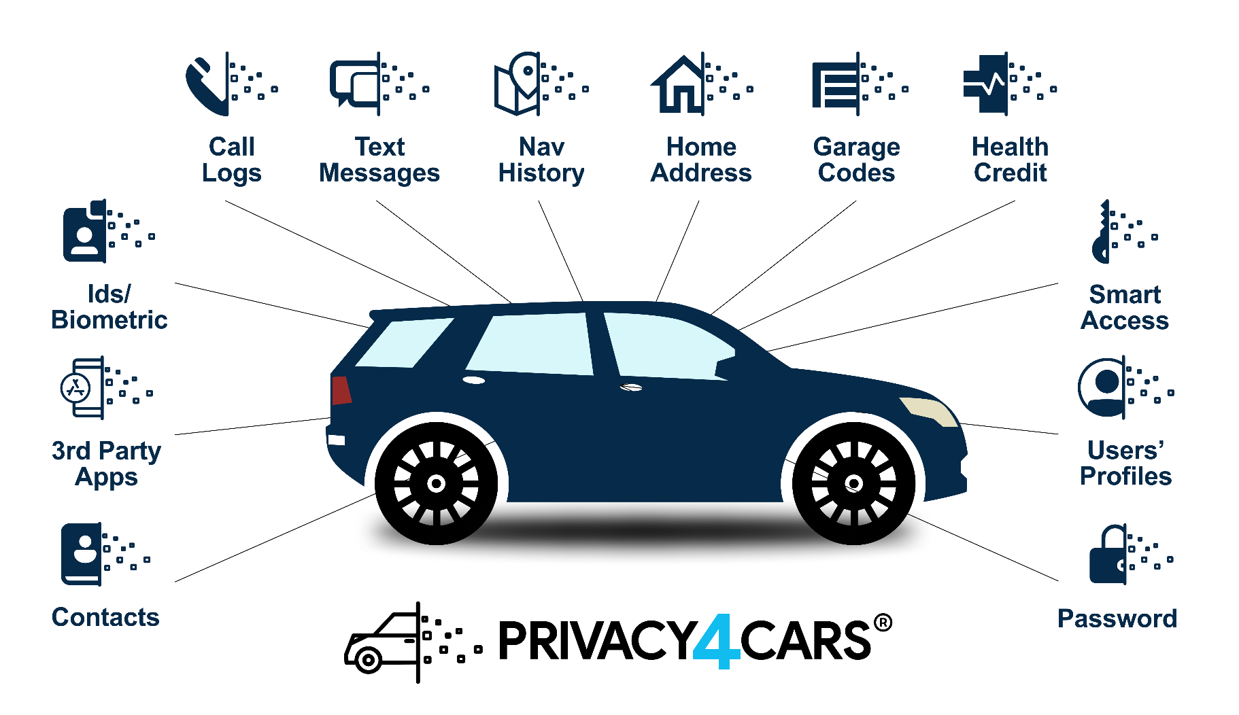


Personal Data Privacy in Vehicles
Notes:
Talk track:
Buyers want personal data privacy in vehicles.
Can you blame them? Today’s cars collect tons of personal data they your customers want to stay in control of.
We’re talking control over who sees their contacts, call logs, text messages, navigation history, and more.
It’s the same as your smartphone – you’d never trade in your phone and expect the next person to have access to your contacts. That’s crazy.
And 39% of today’s car buyers now rank data privacy as 'highly important' - surpassing style, brand, and infotainment features
That's not just a trend - it's an hidden revenue opportunity hiding in every car, or what we look to call an invisible asset
So, give buyers what they want.
[Next slide]

Slide 5
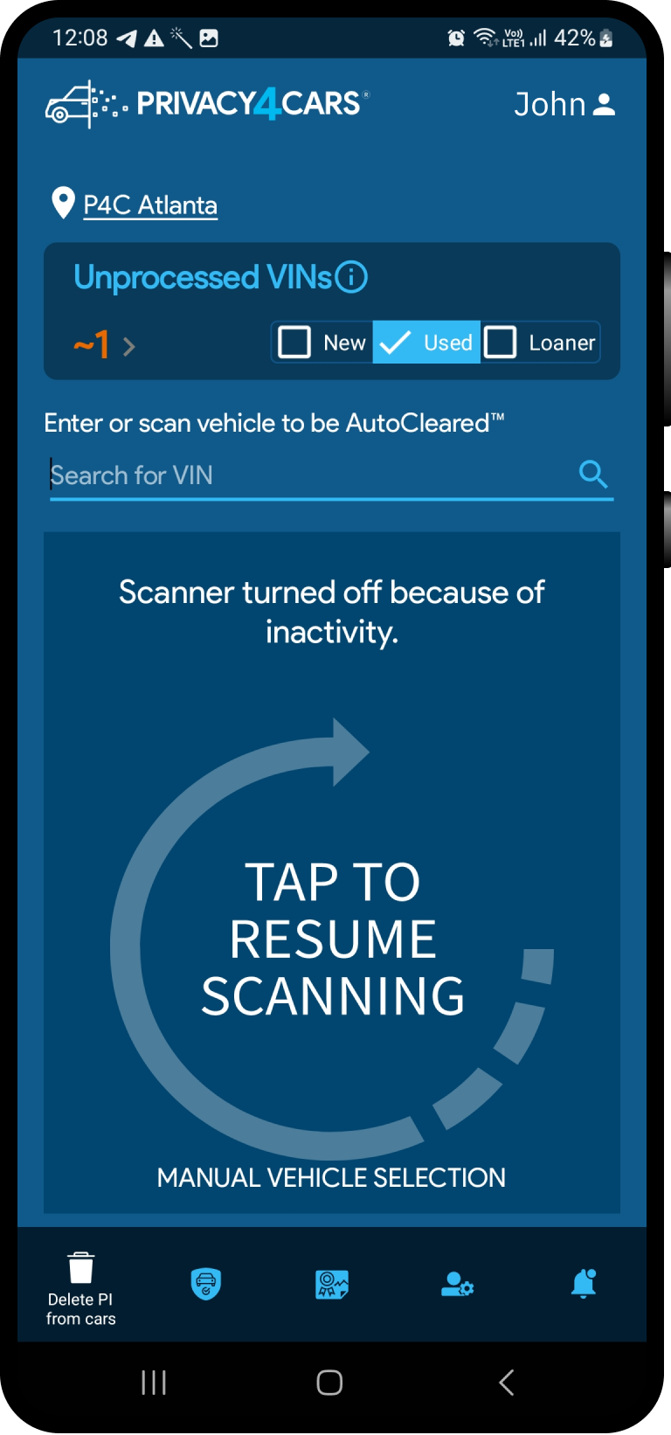
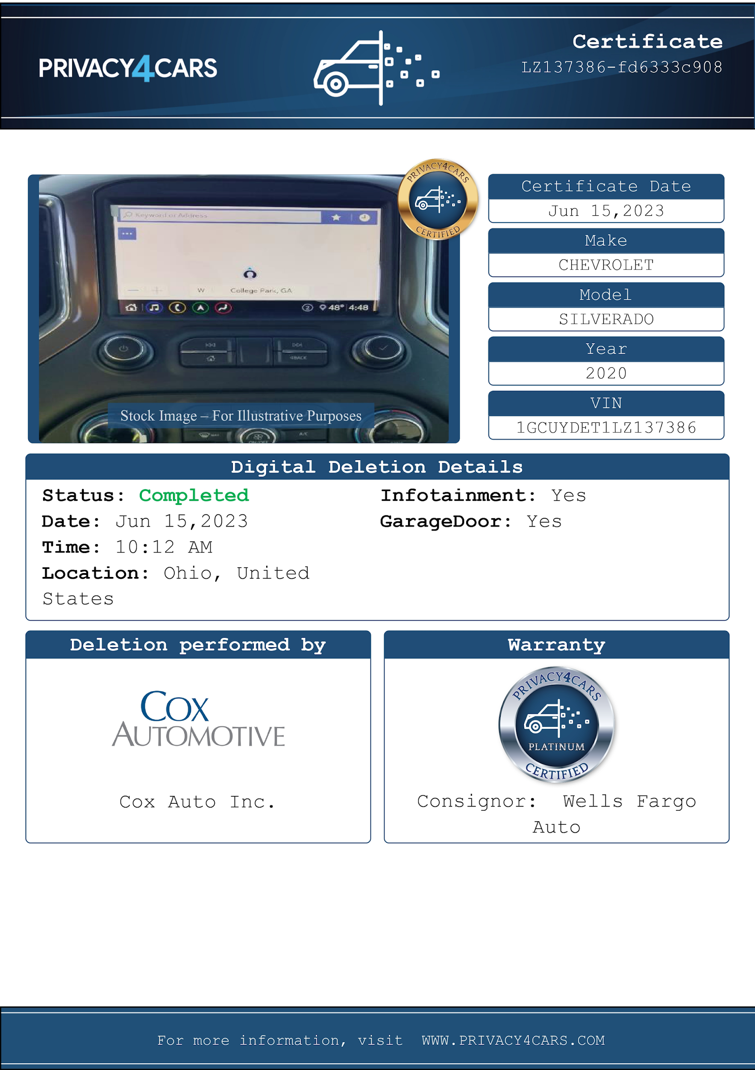
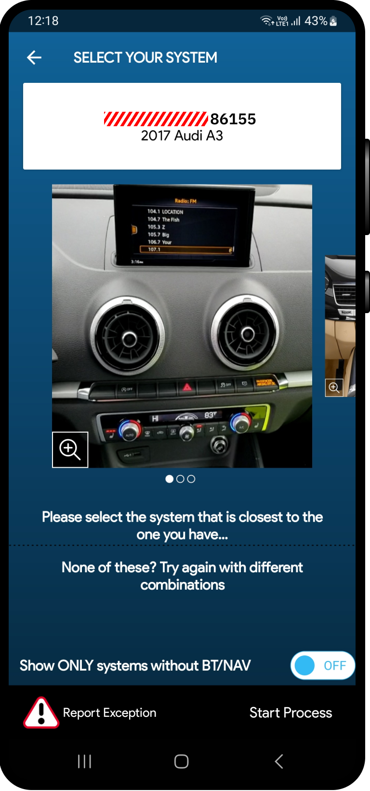
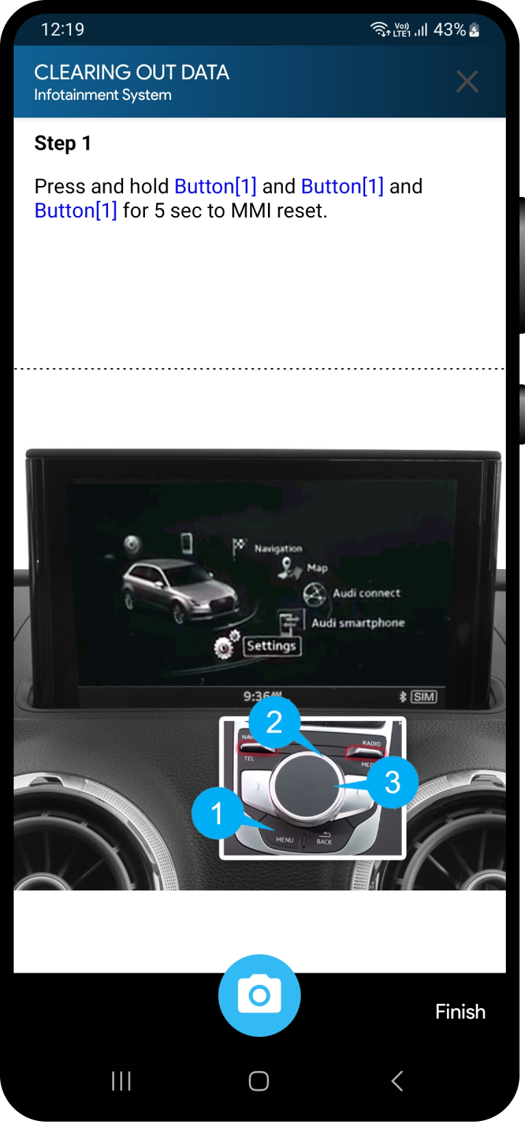
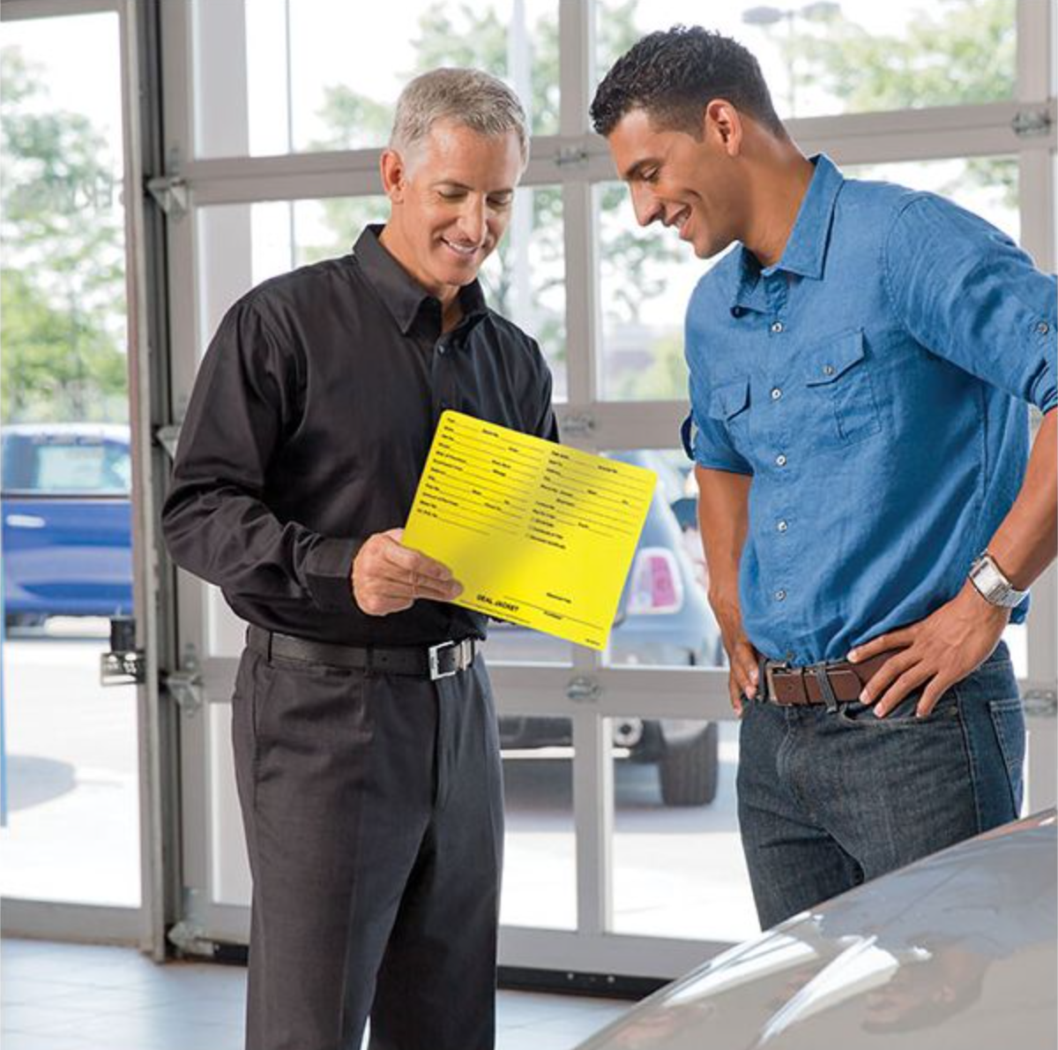
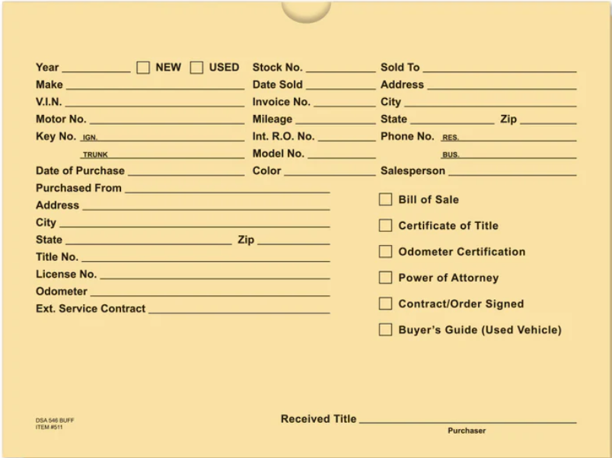
Delete personal data in cars.
Prove it.
Scan
VIN or plate
Select
System
Follow
Step-by-step
Certify
For compliance & customers
Notes:
Talk track:
Give buyers what they want.
Delete their personal data from vehicles at trade in or when you loaners come back by using Privacy4Cars’ by having your technicians use our easy-to-use in-vehicle data deletion app.
Prove it with our certificates.
And then go sell it.

Slide 6
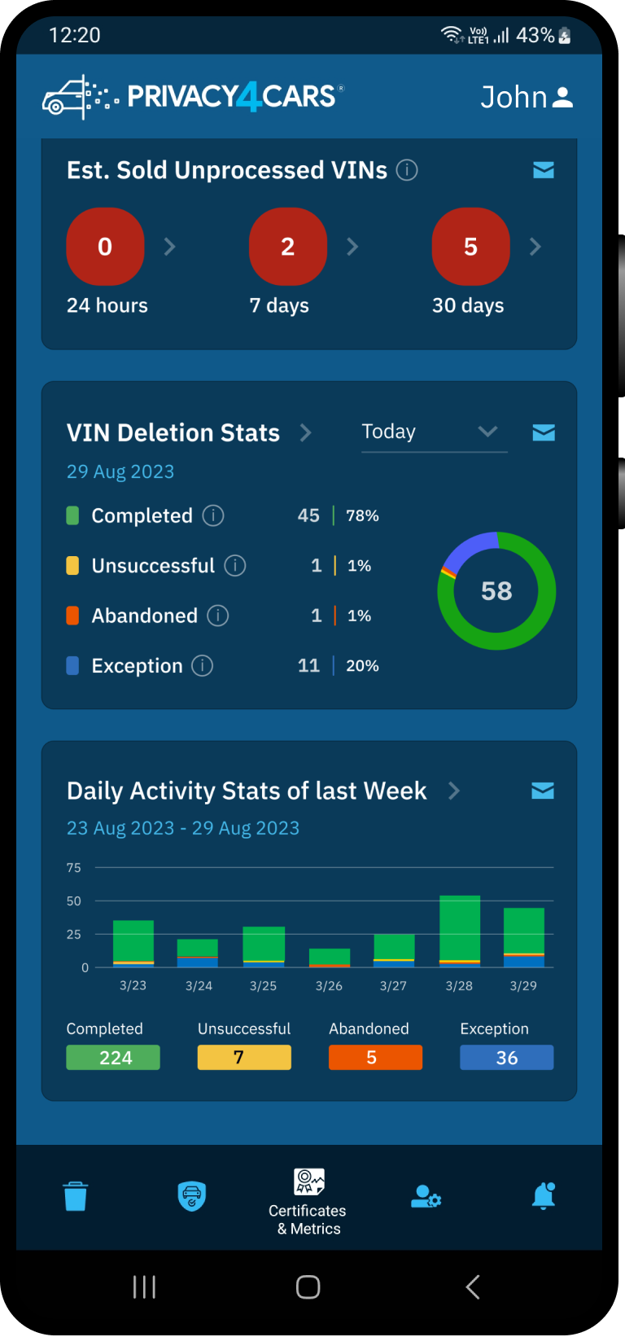
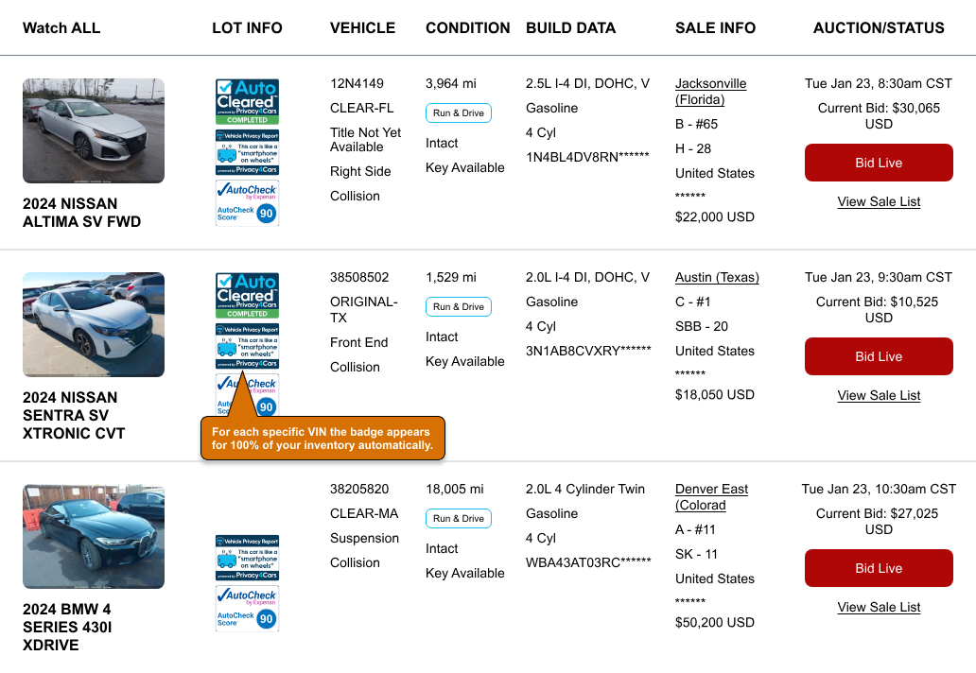
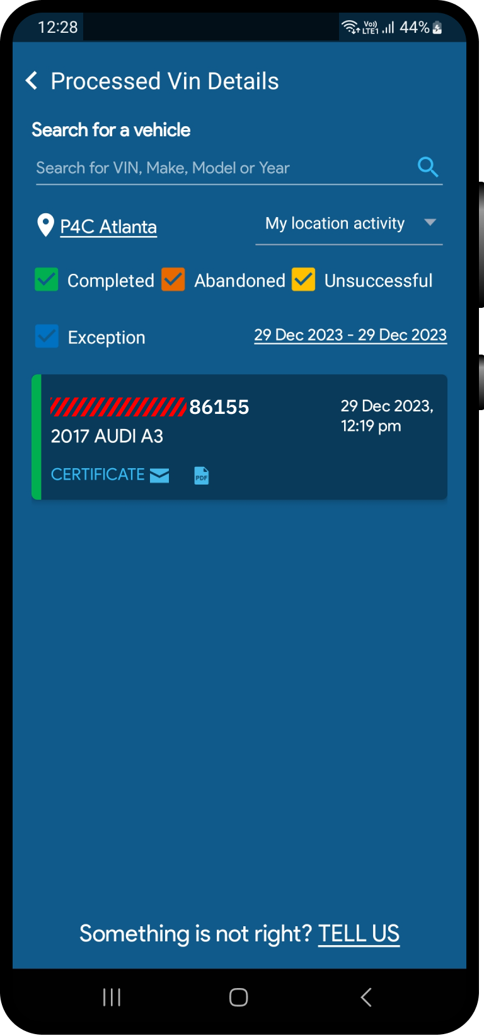
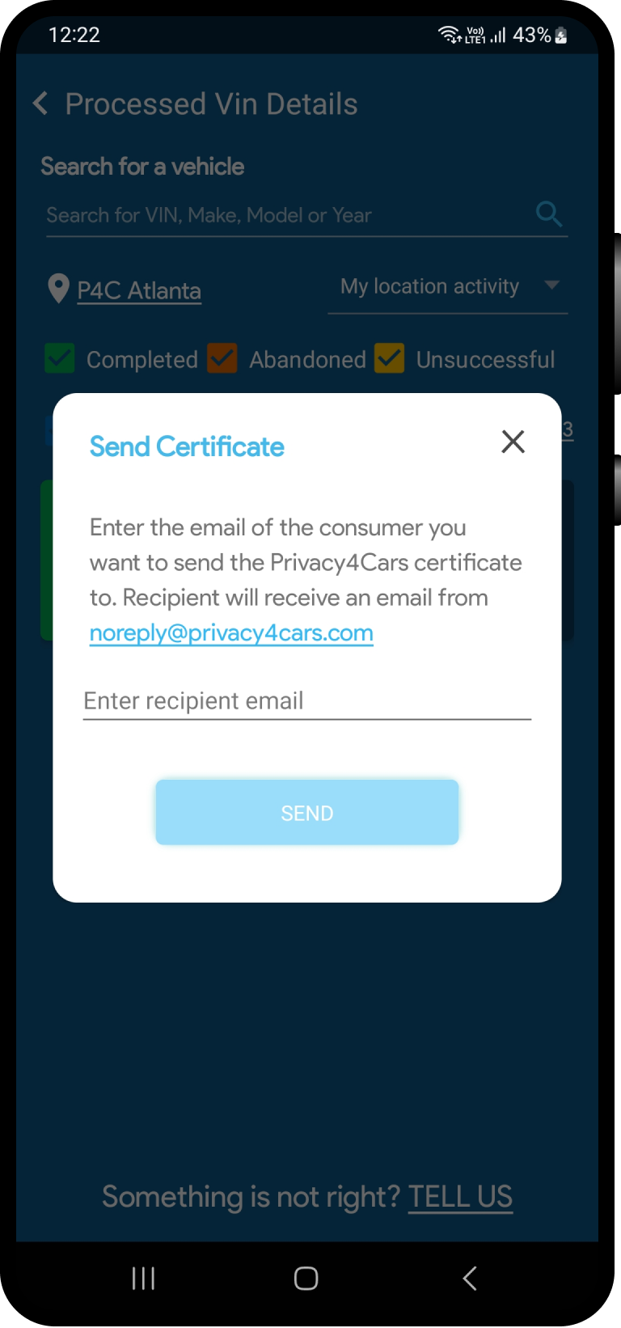
AutoCleared: Execute, Measure, & Display Data Deletion
Efficient Deletion
Rigorous Monitoring
Smart Visibility
Scan
Track KPIs
Smart badges automatically appear on vehicle listings and they link to the certificate of deletion and/or the Vehicle Privacy Report
Select
Inventory status
Follow
Certify
Share certs

Slide 7
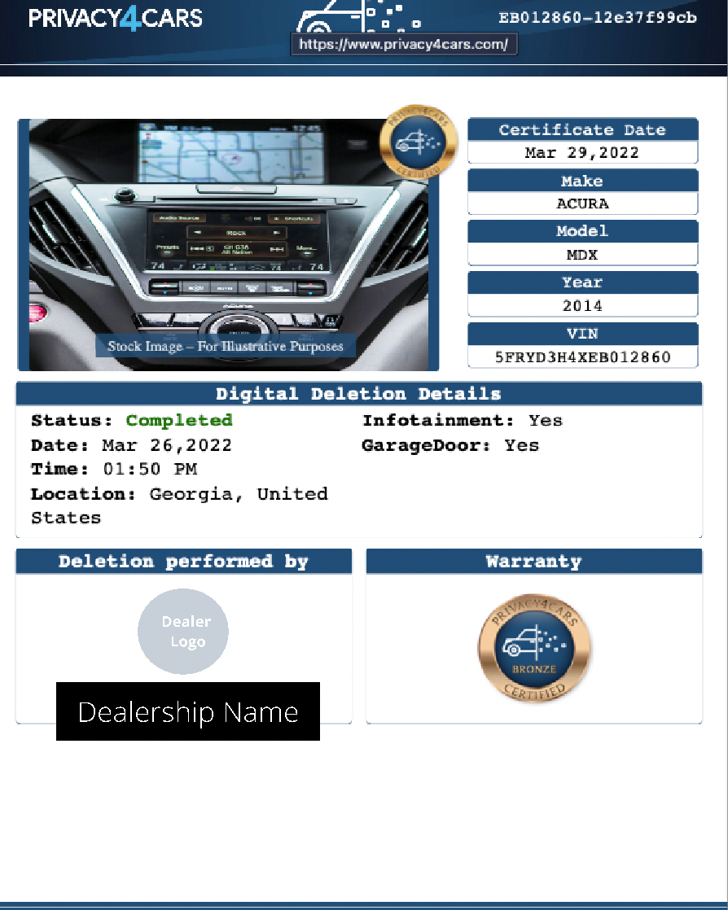
Privacy4Cars Certificate
Certificate of Completion
Simple certificate with vehicle information
Digital Deletion Details
Co-branded with Auction logo
Notes:
Certificate is co-branded, reinforcing your dealership commitment to your customers’ privacy and a real point of differentiation
No work/time required at the F&I office other than handing the certificate and explaining its value (1-2 minutes tops)
“All you can eat” plan: you can issue unlimited certificates for a single monthly fee per rooftop

Slide 8

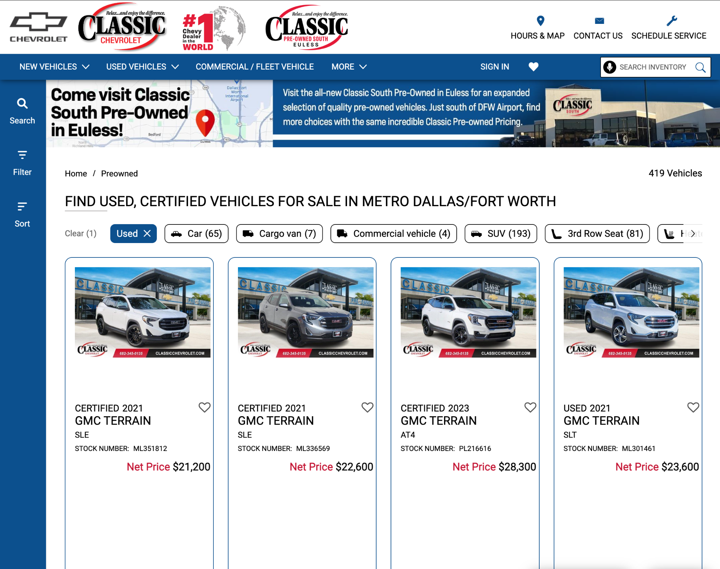

Delete it. Prove it. Sell it.
Web Badges
Notes:
Talk track:
Delete it. Prove it. Sell it.
Remember, 95% of car sales start online. Make privacy visible online.
Put our data deletion certificate badges on your website vehicle listings.
[Next slide]

Slide 9
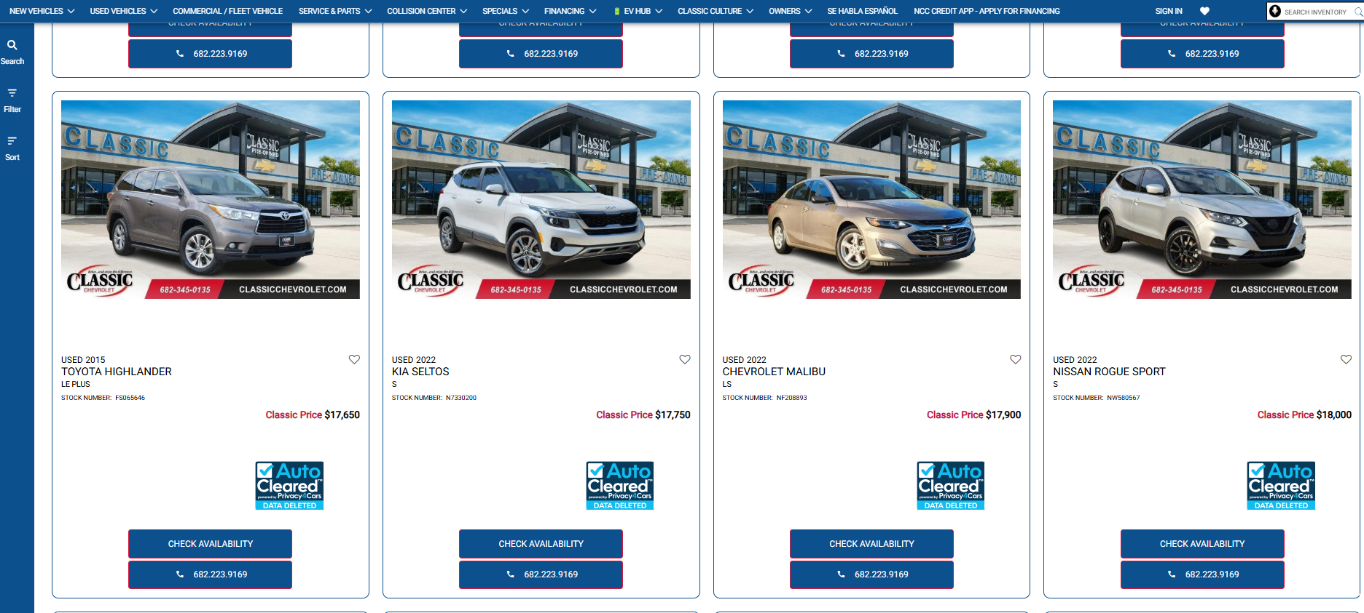
Show it on You Used Vehicle Pages
Notes:
Talk track:
Check this out in real life – pull up Classic Chevrolet, Tom Wood Lexus, or Audi Lubbock’s websites to see for yourself.
They have the Privacy4Cars 100% automated AutoCleared Data Deletion Certificate web badges —- that make your dealership’s commitment to customer privacy visible to buyers.
Differentiate yourself from the competition.
[Next slide]
Classic Chevrolet: https://www.classicchevrolet.com/VehicleSearchResults?search=preowned
Tom Wood Lexus: https://www.tomwoodlexus.com/l-certified-inventory/index.htm
Audi Lubbock: https://www.audilubbock.com/used-cars/lubbock-texas.htm

Slide 10
PROTECTING CUSTOMER INFORMATION ELECTRONICALLY STORED ON
DEALER USED VEHICLE INVENTORY, COURTESY AND RENTAL VEHICLES
Over 80% Of Trade-ins, Courtesy And Rental Vehicles Leave Customer Information Behind
On Vehicle Infotainment Systems
MARKET PROBLEM
DEALER BEST PRACTICES SOLUTION
Digital Retailing and Connected Cars:
• Dealers are responsible for customer data left in vehicles after trade-ins, courtesy cars, or rentals
• Most customers are unaware and that they need to delete their personal information
• State AGs are cracking down to ensure dealers protect this data at all times
Dealers must delete customer data from vehicle infotainment systems in used, courtesy, and rental cars Use VIN-based systems to confirm data and certify deletion for new owners
• A 90-second deletion process ensures personal DATA is recorded in all cases
NURTURING LOYALTY THROUGH TRUST, VALUE AND GROSS PROFIT

Slide 11
FREQUENCY ASKED QUESTIONS
How long is the launch process?
How long does it take to delete the data from each car?
How many vehicle deletions certifications per rooftop?
What’s the average cost per vehicle?
How do I monetize the use of this product?
Generally, 2 to 3 days (up to 12 rooftops)
On average it takes-90 seconds per car
Unlimited certifications (one flat fee per rooftop)
$4 to $5 dollar range per vehicle
Certification CPO addendum, Trade Appraisal, Used Car Purchase, Unlimited
NURTURING LOYALTY THROUGH TRUST, VALUE AND GROSS PROFIT

Slide 12
Revenue Models
  Trade Ins - Customer Data Protection Fee
  Service fee Ensures customer sensitive data is removed from vehicle
  Dealer Addendum added to vehicle, average price range 49.95-99.5
  Used Car Sales – Data removal fee –
  Data removal Fee added to price of vehicle
  Ensures prior customer data access to vehicle features disabled
  Dealer Value Add – No Charge Model
  Demonstrates Dealers Commitment to Customers Privacy
  Add competitive advantage – Cleaned vehicles are badged
  Strong market differentiator
  For more information Call or Text Bob Morgan @ 215 353 0003

Slide 13
ENHANCING CUSTOMER TRUST AND LOYALTY
.
Your commitment to privacy sets your dealership apart
• You are in the business of selling cars, not customer personal data.
Your customers’ privacy is your priority, which is why you offer to delete their personal data from vehicles at trade-in, after test drives, and in your vehicle loaners. Unlike other dealerships, your dealership takes this extra step & go the extra mile to ensure our customers’ privacy.
Your dealership upholds industry-best privacy practices
• You are proud to offer Your customers AutoCleared™ - a multi-patented vehicle data deletion process powered by Privacy4Cars, the world’s leading authority on vehicle privacy and cybersecurity.
You provide the certification to prove the data is deleted
• Unlike other dealerships, You don’t ask our customers to simply take our word that we deleted their personal data

