Slide 1









INTEGRATED VEHICLE SOLUTIONS GROUP LLC (IVSG)
ACCOUNTS RECEIVABLE AUTOMATION
“DEALER”
SEPTEMBER 2025
Copyright (c) 2025 IVSG LLC .ALLRIGHTS RESERVED

Slide 2

Companies Behind Accounts Receivable Automation
INTRODUCING ACCOUNTS RECEIVABLE AUTOMATION
THE ONLY FULLY INTEGRATED DIGITAL A/R SOLUTION WITH DEALERS’ DMS
A Fully Unified A/R Automation Solution For Your Dealership Invoice To Cash Process
AN AUTOMOTIVE RETAIL INDUSTRY FIRST !
So Cash Can Move Without Friction™
VERSAPAY The market leader in Collaborative Accounts Receivable is a FINTECH company specializing in accounts receivable automation for B2B transactions. Founded in 2006 in Vancouver, British Columbia and Headquarters: Miami, Florida
VERSAPAY: The Versapay Collaborative AR Network is the first AR automation solution that empowers the genius of teams by bridging the gap between suppliers and buyers through a shared, digital experience.
Services: AR automation, electronic invoicing, payment processing, virtual card acceptance
VERSAPAY has many clients in multi-verticals and is now entering the automotive retail sector enabled by its strategic partner IVSG
Integrated Vehicle Solutions Group LLC (IVSG) Was Founded Iin 2009 By Peter (Ex President ADP Dealer Services/CDK GLOBAL and CEO of MSX International/Bain capital ) and Bill Russo (Ex VP Custom Development ADP Dealer Services/CDK GLOBAL) In. IVSG and Versapay have an exclusive strategic partnership in marketing and selling the Accounts Receivable Automation Solution to the automotive retail sector. IVSG provides innovative solutions and unique software tools for dealers and their retail partners with proprietary connectors for DMS integration (CDK Global, R &R , Dealertrack, Tekion, Etc.).
IVSG has many of the top 50 dealer groups as clients as well as many heartland dealers: HQ Chicago, offices in Miami, Orlando, Charlotte, Newport Beach, Bhopal India and Portland OR
Copyright (c) 2019-2025 IVSG LLC .ALLRIGHTS RESERVED
Copyright (c) 2025 IVSG LLC .ALLRIGHTS RESERVED

Slide 3
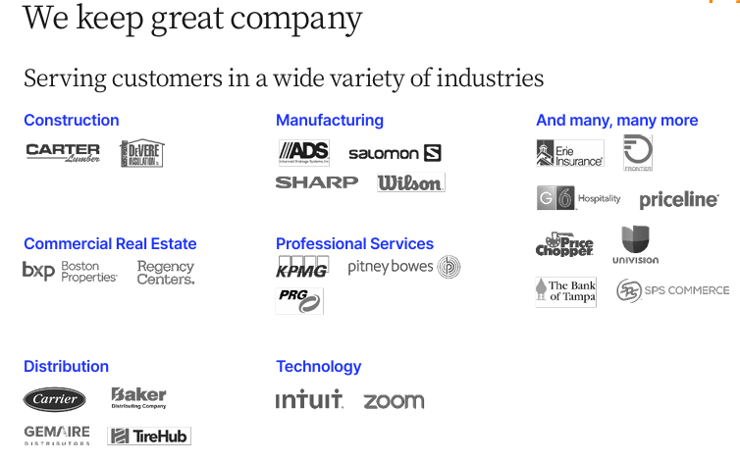
+
IVSG HAS NOW ENABLED VERSAPAY TO ENTER THE AUTOMOTIVE RETAIL SECTOR UNDER AN EXCLUSIVE PARTNERSHIP TO SERVE AUTO DEALERS
AND THEIR RETAIL PARTNERS
Copyright (c) 2025 IVSG LLC .ALLRIGHTS RESERVED

Slide 4
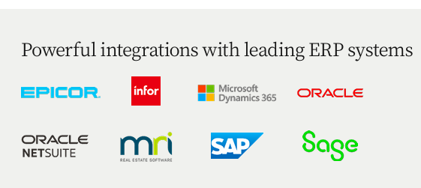
MARKET LEADING AGNOSTIC DMS/ERP INTEGRATION PROVIDER
FOR AUTOMOTIVE DEALERS AND THEIR RETAIL PARTNERS
Copyright (c) 2025 IVSG LLC .ALLRIGHTS RESERVED

Slide 5

ACCOUNTS RECEIVABLE AUTOMATION- WHAT MAKES US THE BEST SOLUTION IN THE INDUSTRY
SETTING A NEW STANDARD FOR DEALERSHIP A/R COLLABORATION AND AI CASH APPLICATION
Automate All Your Manual Accounts Receivable Processes—INCLUDING DMS INTEGRATION
Spend less time on low-impact activities and more time focusing on growth with end-to-end automation. Let Versapay handle: ‏‏‎ ‎
✔️ Invoice delivery and presentment
✔️ Dunning notifications
✔️ Basic collections activities
✔️ Cash application and reconciliation
Resilient Dealer Accounting And Parts Teams Run On Versapay
WHY VERSAPAY
They use data and automation to take control of cash flow—predicting payment behavior, streamlining invoicing and collections, and making faster financial decisions with AI.
50% less time managing receivables
25% faster payments
30% fewer past-due invoice
Copyright (c) 2025 IVSG LLC .ALLRIGHTS RESERVED

Slide 6
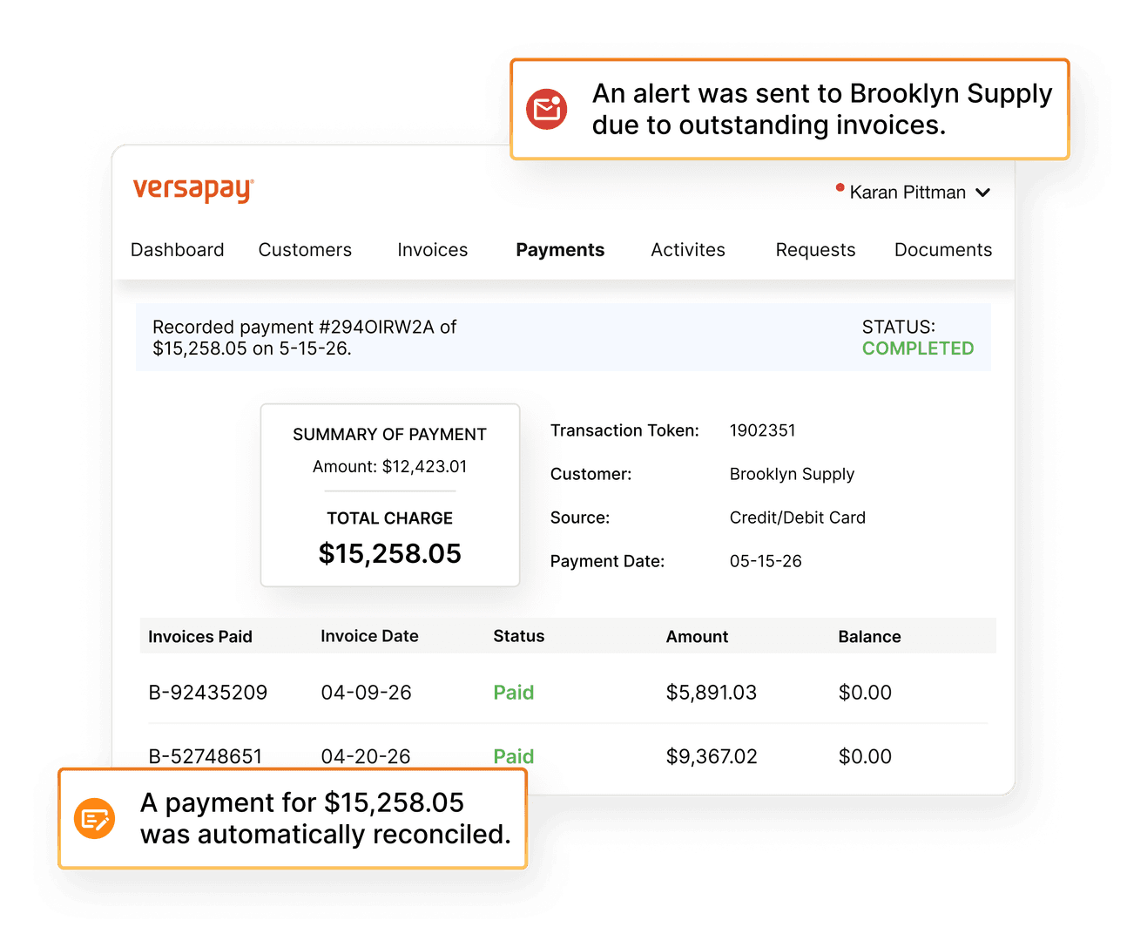

A Fully Unified Solution For Your Invoice To Cash Process
SO CASH CAN MOVE WITHOUT FRICTION™
ABC AUTO DEALER
Copyright (c) 2025 IVSG LLC .ALLRIGHTS RESERVED

Slide 7
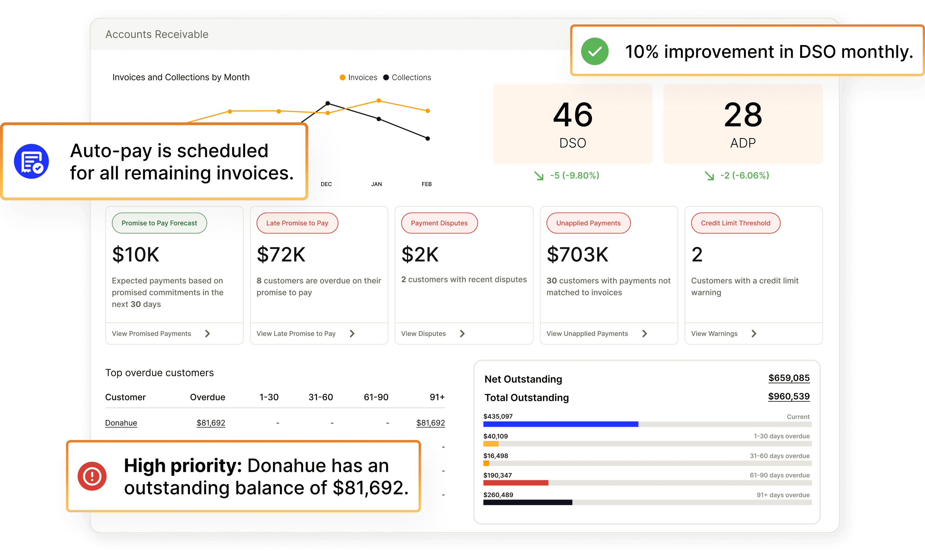
A Fully Unified Solution For Your Invoice To Cash Process
SO CASH CAN MOVE WITHOUT FRICTION™
ABC AUTO DEALER
Copyright (c) 2025 IVSG LLC .ALLRIGHTS RESERVED

Slide 8
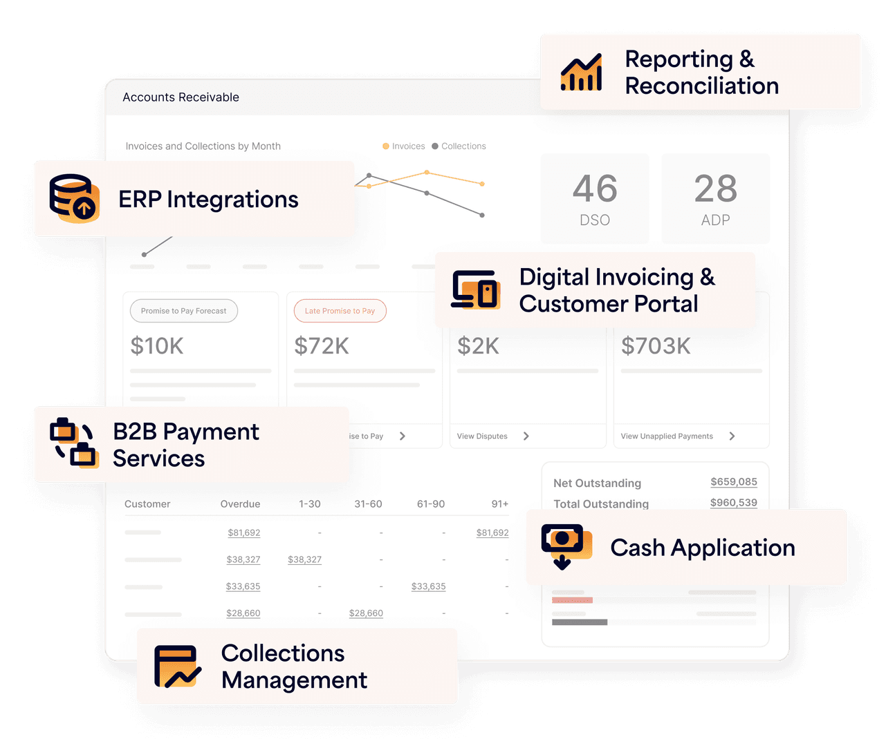
The A/R Automation Platform For Turning
Cash Flow Chaos Into Clarity
Versapay's accounts receivable automation platform brings together invoicing, collections, payments, cash application and reporting to simplify the entire invoice to cash process.
ABC AUTO DEALER
Copyright (c) 2025 IVSG LLC .ALLRIGHTS RESERVED

Slide 9
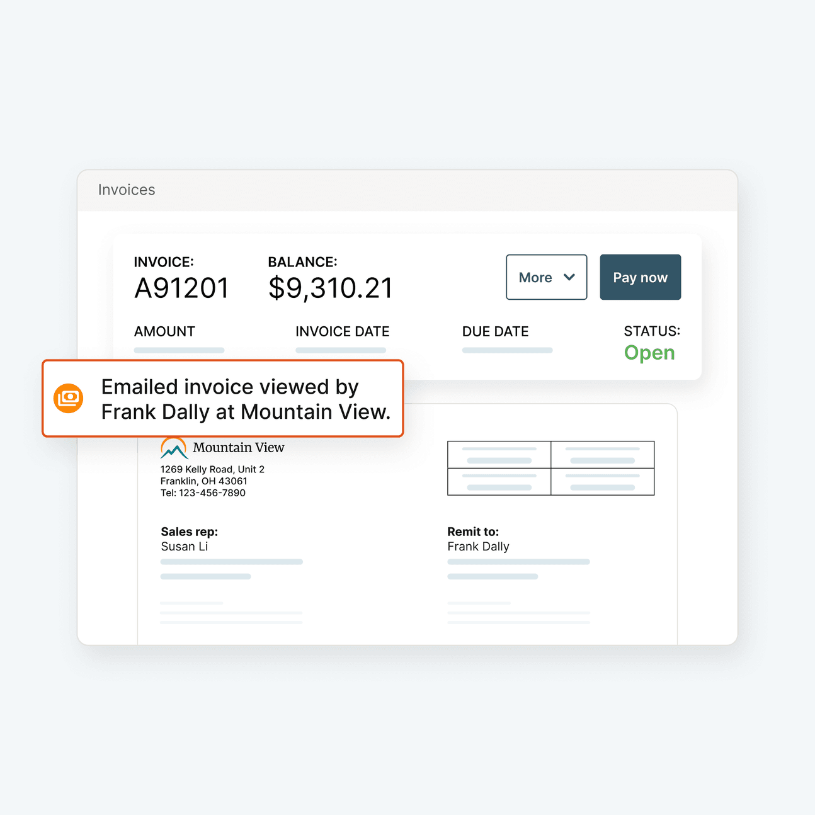
Process And Reconcile Incoming Payments Automatically
When customers pay, Versapay captures, processes and applies payments automatically, reconciling them to invoices and posting to your DMS/ERP in real-time. No manual entry, just seamless, straight-through processing that accelerates cash flow and reduces errors.
ABC AUTO DEALER
Copyright (c) 2025 IVSG LLC .ALLRIGHTS RESERVED

Slide 10
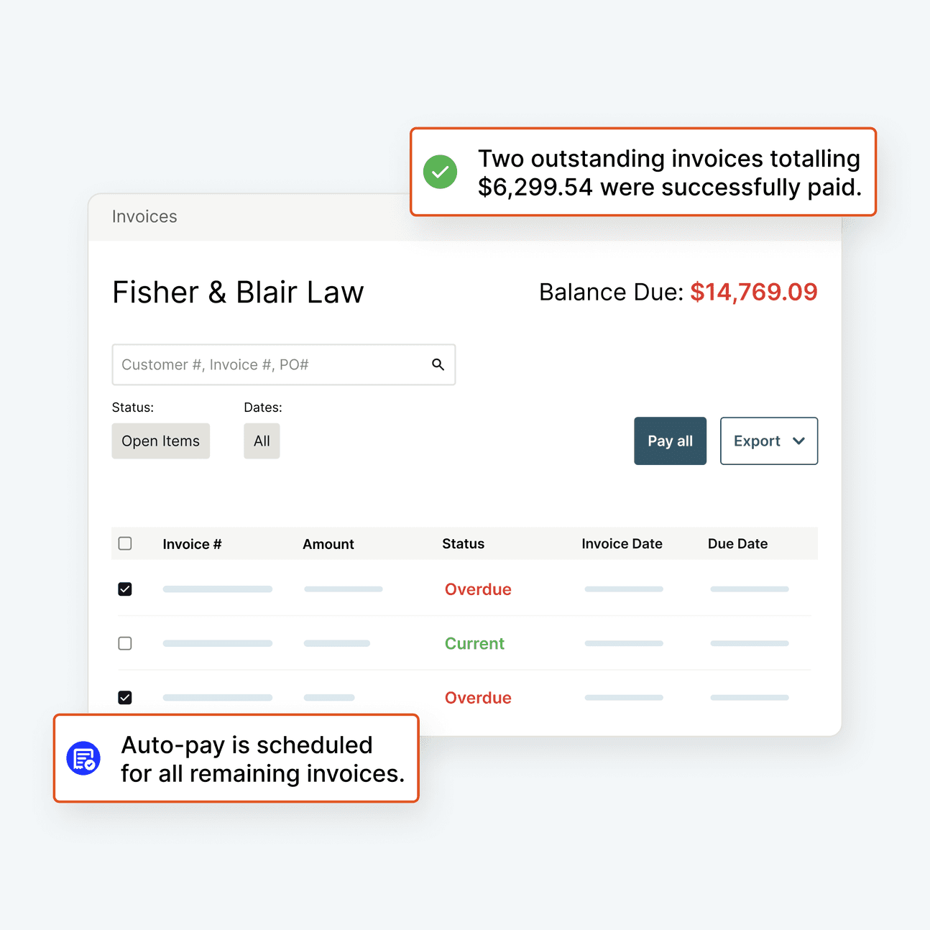
Enable Self-service Payments In An Easy-to-use Portal
Take advantage of a branded customer portal for your customers to view invoices, make payments, and manage their account. Let them pay using preferred payment methods—credit card, ACH, virtual card—schedule recurring payments and pay multiple invoices at once‎
ABC AUTO DEALER
Copyright (c) 2025 IVSG LLC .ALLRIGHTS RESERVED

Slide 11
A Fully Unified Solution For Your Invoice To Cash Process
SO CASH CAN MOVE WITHOUT FRICTION™
Before we organize a brief meeting/demo with our product specialists, it would be helpful to have the following information so that we can provide you with a high-level ROI during or before the meeting:
# of vendors per dealer rooftop
# of monthly invoices and average vendor invoice value per dealer rooftop
DSO by rooftop or dealer group
DMS platform used by your dealer group
START YOU’RE A/R AUTOMATION TRANSFORMATION
CONTACT US
GARY MITCHELL- 407-342-2061; GARY.MITCHELL@IVSGLLC.COM
Copyright (c) 2025 IVSG LLC .ALLRIGHTS RESERVED

Slide 12






KEY NEXT STEPS
THANK YOU FOR YOUR TIME TODAY
WELCOME TO INNOVATION
Copyright (c) 2025 IVSG LLC .ALLRIGHTS RESERVED

