Slide 1
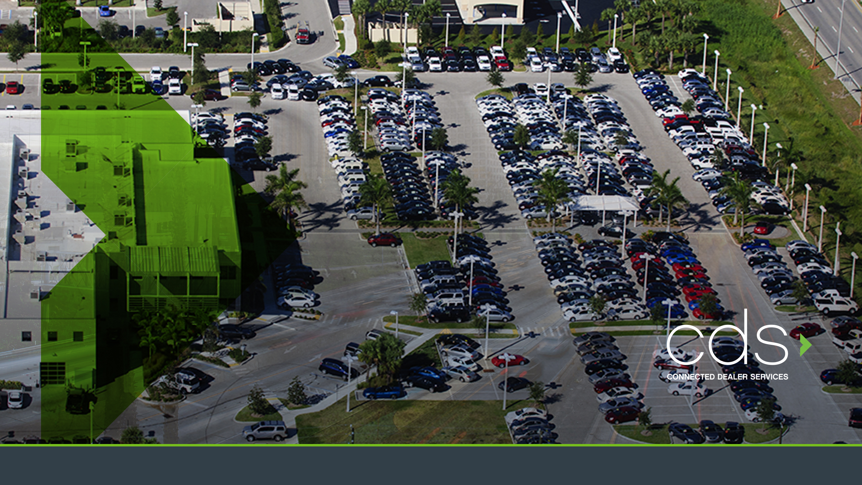
Lot Management
Profit Center
CAR RX Service Retention
550 DEALERS NATIONWIDE
Notes:
Dealer management profit center

Slide 2
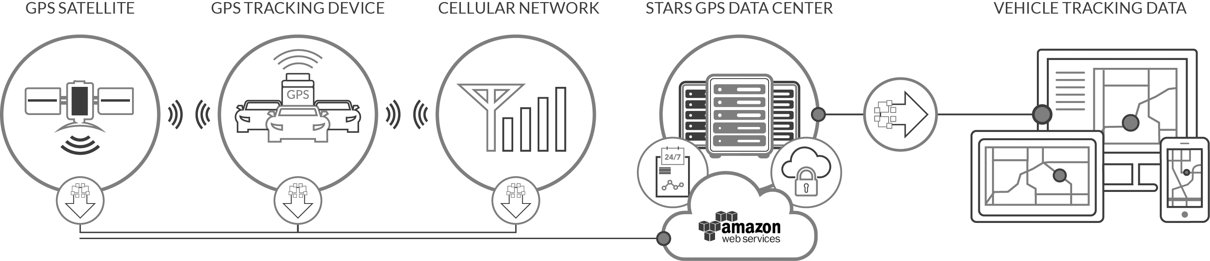
Dealer Management and Profit Center
What It Is:
Connected Dealer Services (CDS) is an advanced GPS cloud based Dealer Management and Profit system designed exclusively for Auto Dealers to protect their vehicle assets, manage inventory, reduce costs, improve staff and operational efficiency, increase service retention and provide a significant value added profit center at the point of sale.
The system offers the latest GPS technology designed around the unique needs of new car dealerships to create a comprehensive system that enables faster, smarter and more streamlined operational decisions.

Slide 3


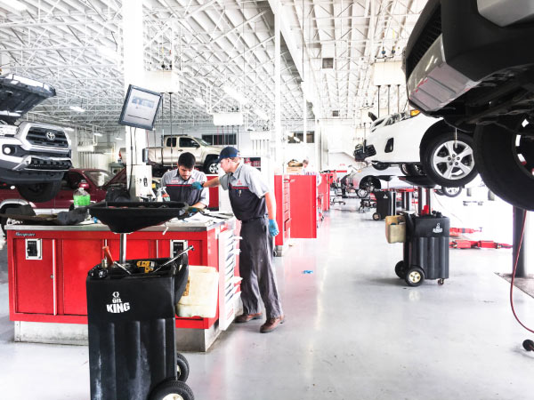
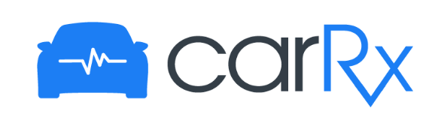
IMPACT – Revenue / Profit
Comprehensive Lot Management
NEW PROFIT CENTER
New CAR RX- Service retention
PRE-VEHICLE SALE
POST-VEHICLE SALE
Instant Vehicle location - All Staff
Eliminate dead battery-low fuel issues
Multiple Geo Fences protect lots afterhours
POINT OF SALE
Hard Add – Non Cancellable
Hi Value, feature rich F&I product
Average Gross - $800+
Now with CAR RX!
CAR RX health maintenance
Service - Customer Retention Dealer Branded Passive Auto Marketing

Slide 4
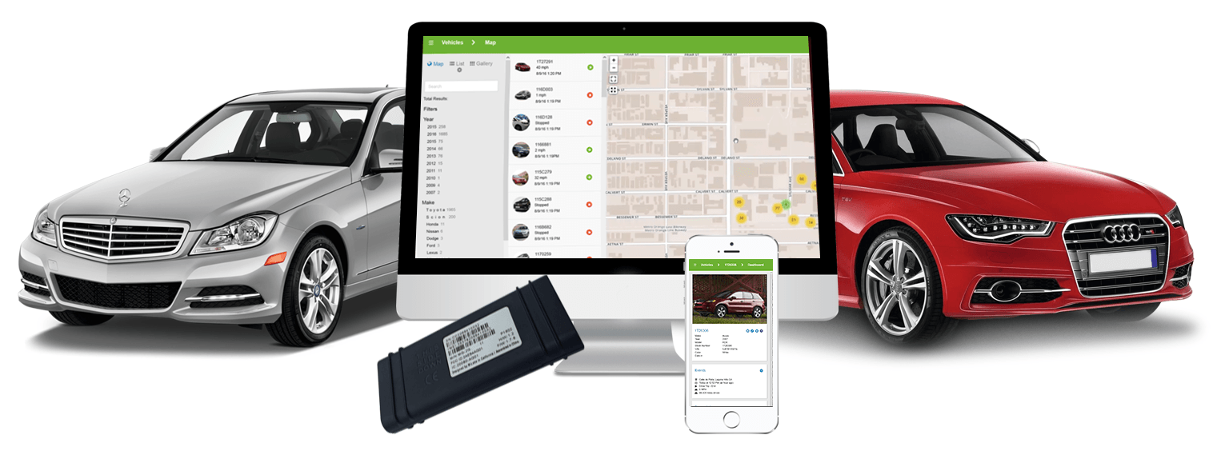
IMPACT - Lifecycle Management Solutions
Communication / Relationship Platform – Own the relationship with your customer
1
Adds Profit to Every Vehicle
2
3
Improves Inventory Management Processes from Intake to Service, through Sales and Finance and Protects Inventory - SVR
4
Increases Service Retention, $$ per R.O.

Slide 5
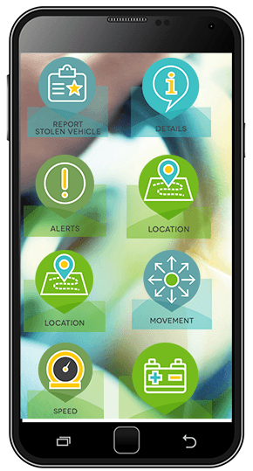
It’s a Win-Win!
Dealer
Consumer
✓ | F&I Profit Center
✓ | Lot Control & Inventory Management
✓ | Streamline Inventory Audits
✓ | Manage Inventory Health - Low Battery Alerts
✓ | Locate Vehicles Instantly with Mobile App
✓ | Real-Time Service Reminders
✓ | Increase Service Retention and CSI
✓ | Anytime Access - App Keeps You Connected to Your Car & Family
✓ | Teen/High Risk Driver Monitor System
✓ | Geo Fence Boundary
✓ | Real-Time Location & Location History
✓ | Low Battery Alerts
✓ | Service Notifications & Check Engine Alerts
✓ | 24X7 Stolen Vehicle Recovery Service
Notes:
More visual … profit

Slide 6

Dealership Support
Channel Managers
Partner with Agents to capture business
Product Deployment Specialists
Pre-Launch and at Launch Management and Support
Regional Performance Managers
Build Dealership performance w/ assessment, process, and training
Average Sell Through Rate = 60% +
6
I ELO
Notes:
Case studies

Slide 7





Dealership Implementation
Train Service/ Parts department on Installation and inventory of devices
Train Service Department on service intervals with exact miles and engine light notifications
Install Device on Entire Inventory
Provide onsite training for Sales Team and F&I Managers on system usage and F&I sale of Elo GPS product
Provide Materials and ongoing training to ensure proper penetration and proper installation and stocking procedures
Notes:
Case studies

Slide 8
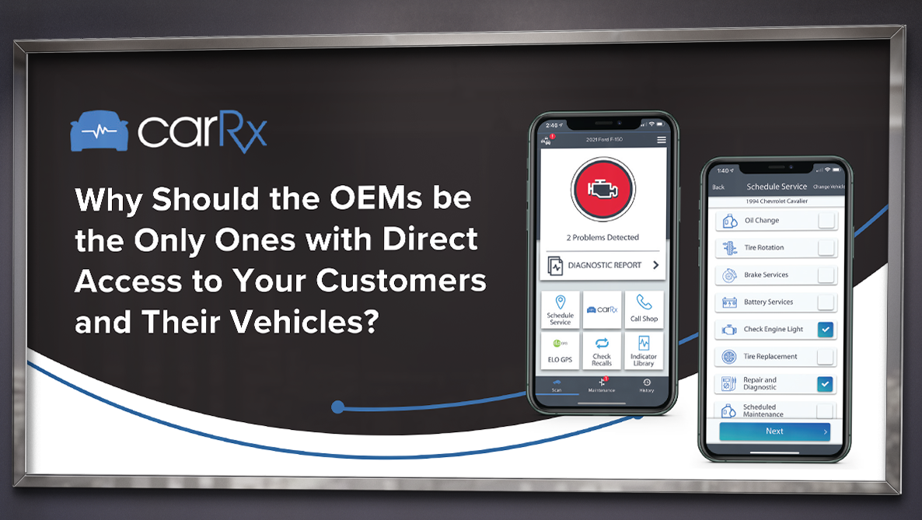
Dealer Tools
74%
of Buyers who had their vehicle serviced at the selling dealership said they would return to the selling dealership to purchase their next car
71%
of Buyers stated they want easy to understand vehicle health and maintenance information
8

