Slide 1

















UNLIMITED DELETIONS PER ROOFTOP!
ONLY
$695
REGULARLY $995
$295 One Time Activation - Onboarding Month to Month - No Risk - Cancel Anytime
Online Training – Any One Can Do It – 24/7 How To Videos
The Bottom Line — Your Dealership Is Legally Responsible. FTC Safeguards Rule GLBA Act * 2024 State Privacy Laws
New Revenue Stream: $99/car, scalable upsell
Speed & Simplicity: Complete data deletion in 90 seconds Compliance Pressure: FTC and Attorney General scrutiny Smart Business: Protect your reputation and your customers
REVENUE MODEL
Turn Compliance Into a Profitable Revenue Stream
$99.00 Suggested Retail – Per Vehicle
90 Seconds – 4 Easy Steps
Your commitment to privacy sets your dealership apart.
LET’S MAKE SURE YOU ARE IN COMPLIANCE.
CALL Today
215-353-0003
Auto
Dealer Compliance Division Exclusively for Auto Dealerships & Auctions Only Patented – Certified Data Deletion To
Date Over 2 Million Cars Processed0
State Mandatory Privacy Law:
New Jersey, Delaware, Maryland, Connecticut
Pending, New York, Pennsylvania,
Connecticut and more.

Slide 2

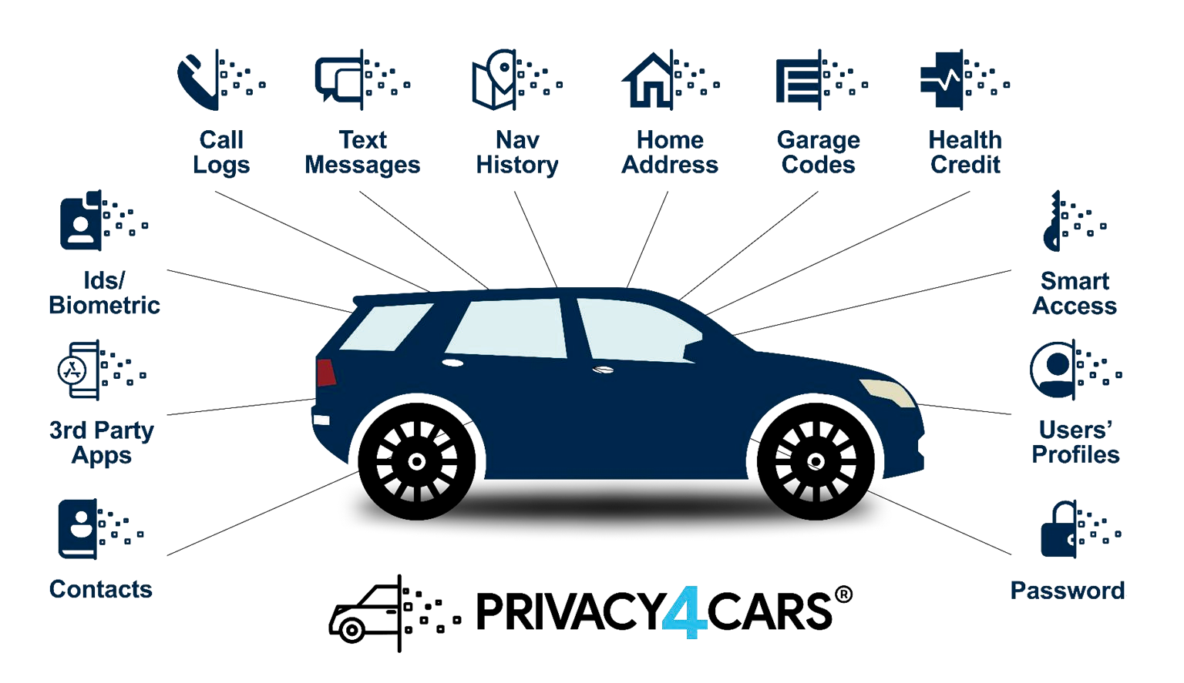


Our Solution
Designed exclusively for Automotive Dealerships
Unlimited deletions- One low monthly cost $595 Simple 90 second data deletion process Validates and Certifies deletion by VIN with full audit trail
Customer receipts verify data deletion was completed
Turns Compliance into new profit center
Meets state and federal compliance regulations Auto Link certificate badges to your website vehicle listings.
Value adds dealers CPO program
Are you aware of how much consumer personal data is captured?
Let us show you how to turn compliance into
PROFIT!
Does your dealership have a Customer Personal Data Deletion Policy?

