Slide 1

WARRANTY RATE AI™---BEST WARRANTY REIMBURSEMENT SOLUTION
WE DO ALL THE WORK FOR DEALERS’ OEM OR STATUTORY SUBMISSION

Slide 2

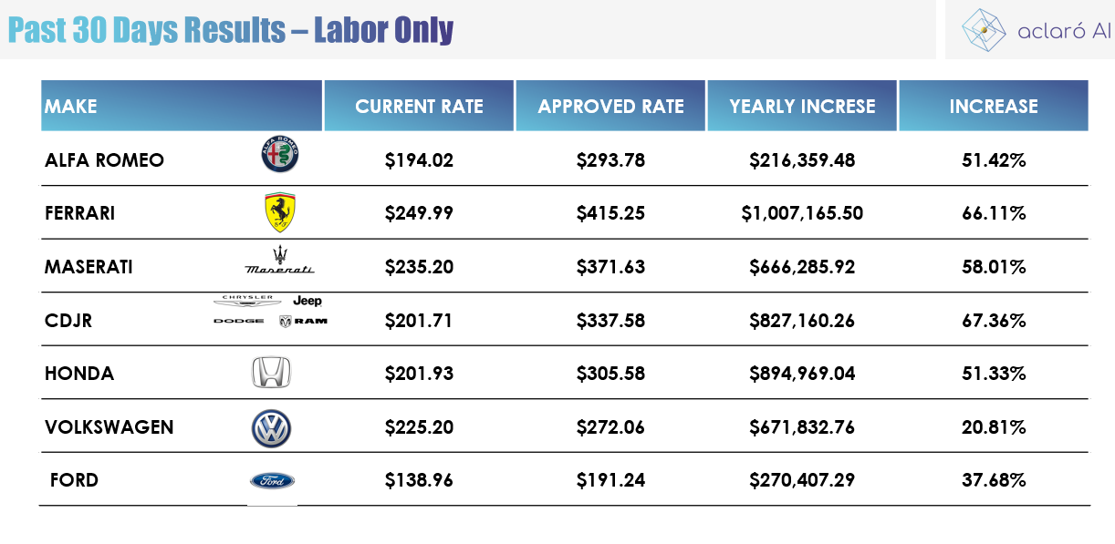
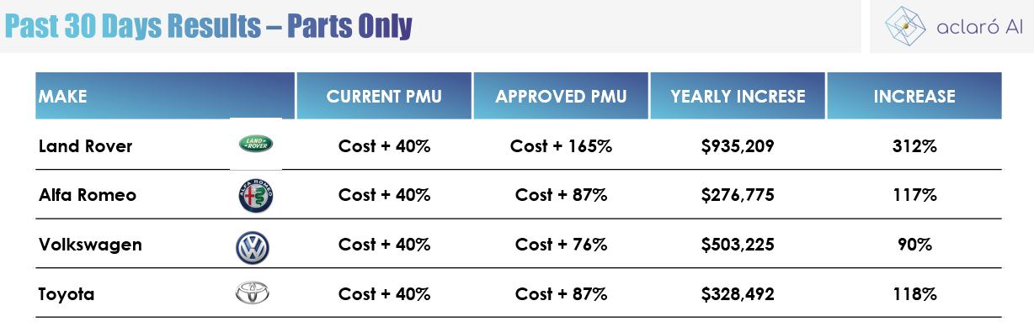




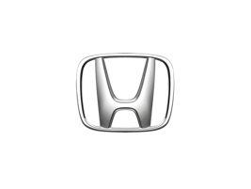

WARRANTY RATE AI™---BEST WARRANTY REIMBURSEMENT SOLUTION

